Slide 1
Guarantee and Number of Health Facilities in West Java Project TAKEN FROM CASE STUDY RevoU Mini Course - Data Analytics
Dhea Amalia Lutfiani
( 17 Oct – 21 OCT )

Slide 2


Slide 3
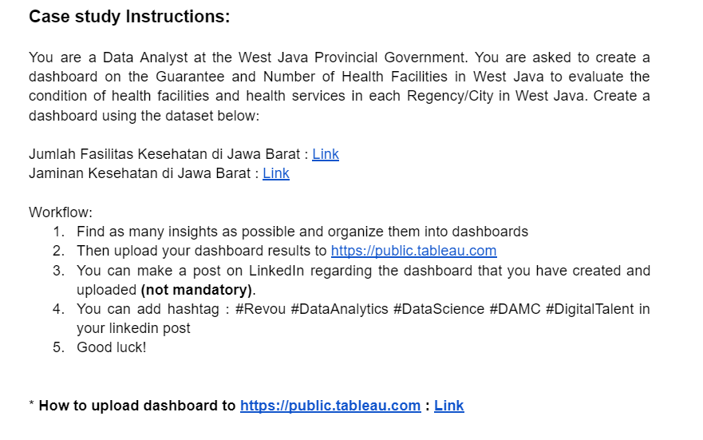

Slide 4
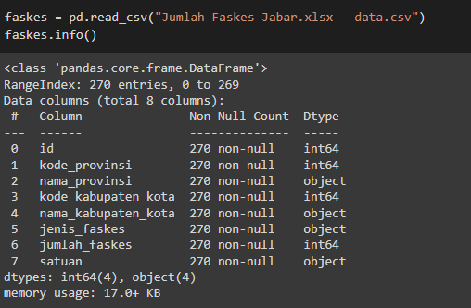
Preview Data
Info from Dataset – Jumlah Faskes Jabar
From this information, it can be seen that:
There are 8 columns and the amount of data varies is 270 data
The data type of the salary dataset are int64 and object

Slide 5
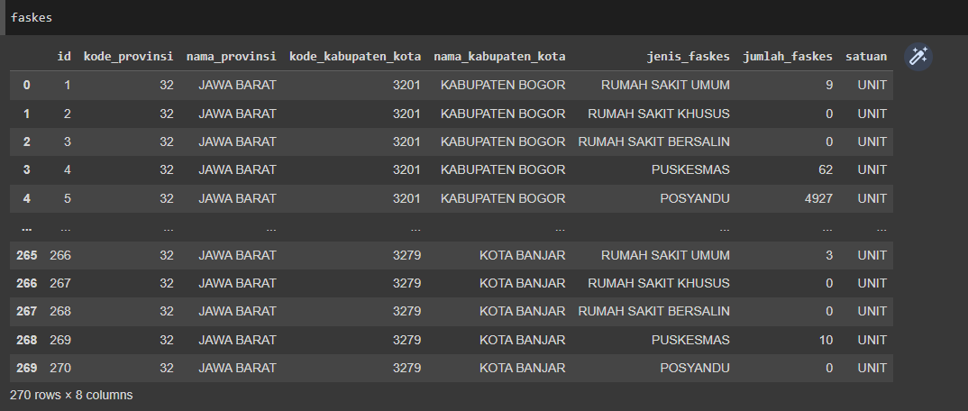
Preview Data
Preview the Dataset

Slide 6
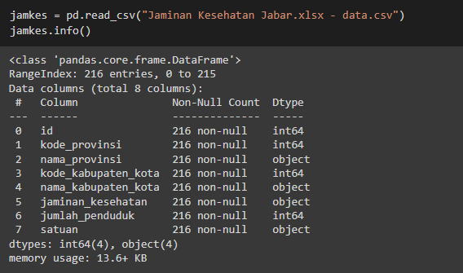
Preview Data
Info from Dataset – Jaminan Kesehatan Jabar
From this information, it can be seen that:
There are 8 columns and the amount of data varies is 216 data
The data type of the salary dataset are int64 and object

Slide 7
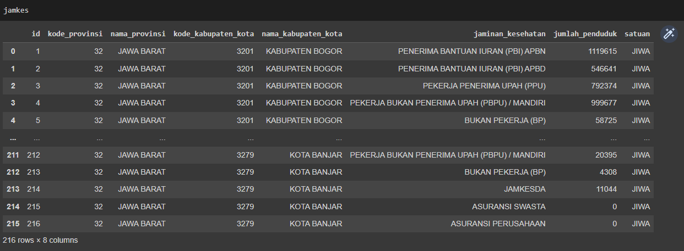
Preview Data
Preview the Dataset

Slide 8
Defining Question
Find as many insight as possible and organize them into dashboards
Most Health Facilities in West Java Province
City/Regency with The Most Health Facilities in West Java
Existing Health Insurance vs Number of Registered Population
Distribution of population in West Java
What is the relationship between the number of health facilities and the population?

Slide 9
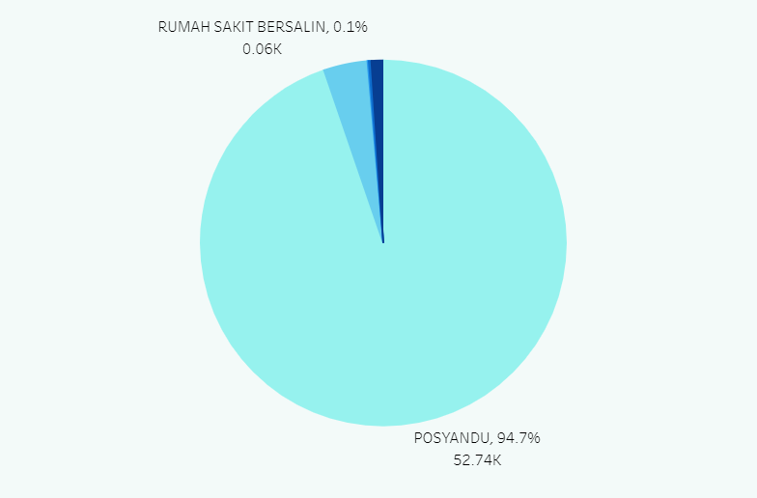
Visualization with Insight
Most Health Facilities in West Java Province
The most common types of health facilities are POSYANDU health facilities, reaching 94.7% of all health facilities in West Java.

Slide 10
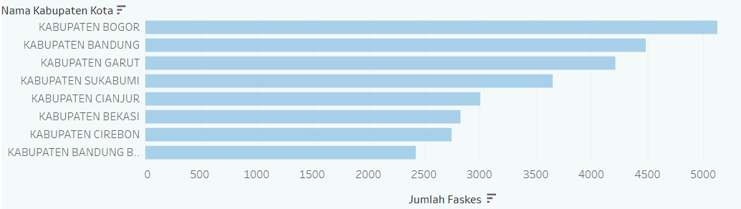
Visualization with Insight
2. City/Regency with The Most Health Facilities in West Java
In the visualization above, there are the top 8 cities/regencies with the most health facilities in West Java, with Bogor Regency being the first rank with 5,128 units of health facilities.

Slide 11
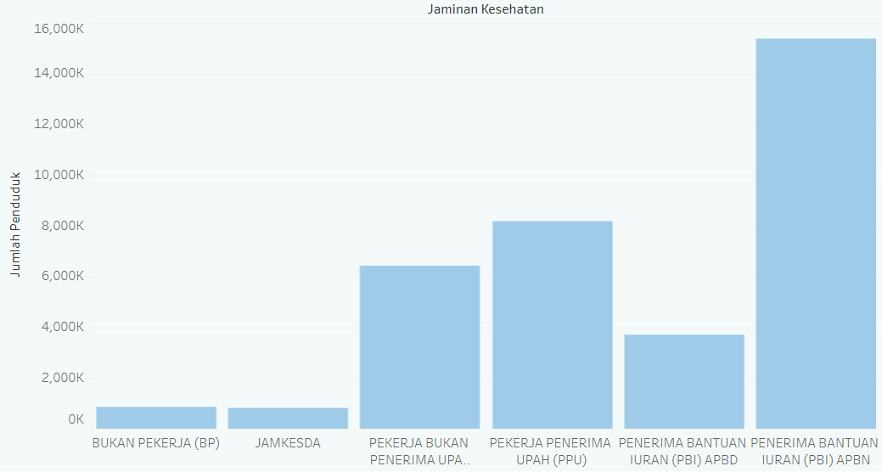
Visualization with Insight
3. Existing Health Insurance vs Number of Registered Population
Judging from the existing population, the most widely used type of health insurance is “Penerima Bantuan Iuran (PBI) APBN" with a population of 15,364 thousand people.

Slide 12
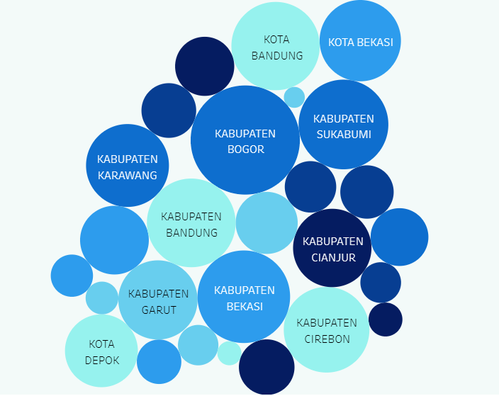
Visualization with Insight
4. Distribution of population in West Java
The following is the distribution of the total population in West Java, where the size of the existing circle represents the value of a large population.

Slide 13
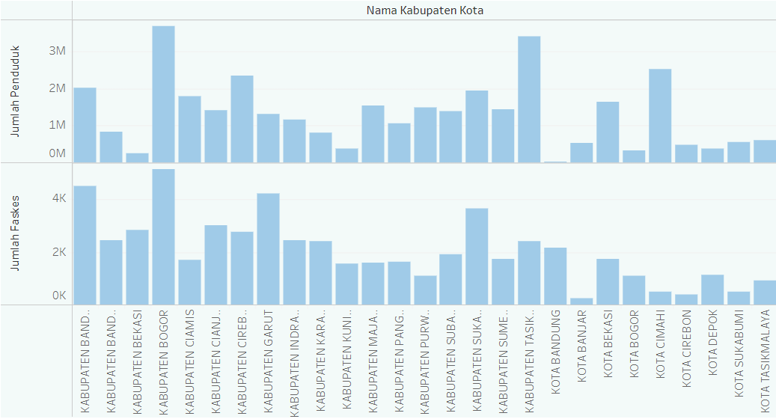
Visualization with Insight
5. What is the relationship between the number of health facilities and the population?
The following visualization illustrates the relationship between the variable population and the number of health facilities, in which to produce good services and a prosperous society the number of health facilities must be balanced with the population, in order to cover the existing problems.

Slide 14
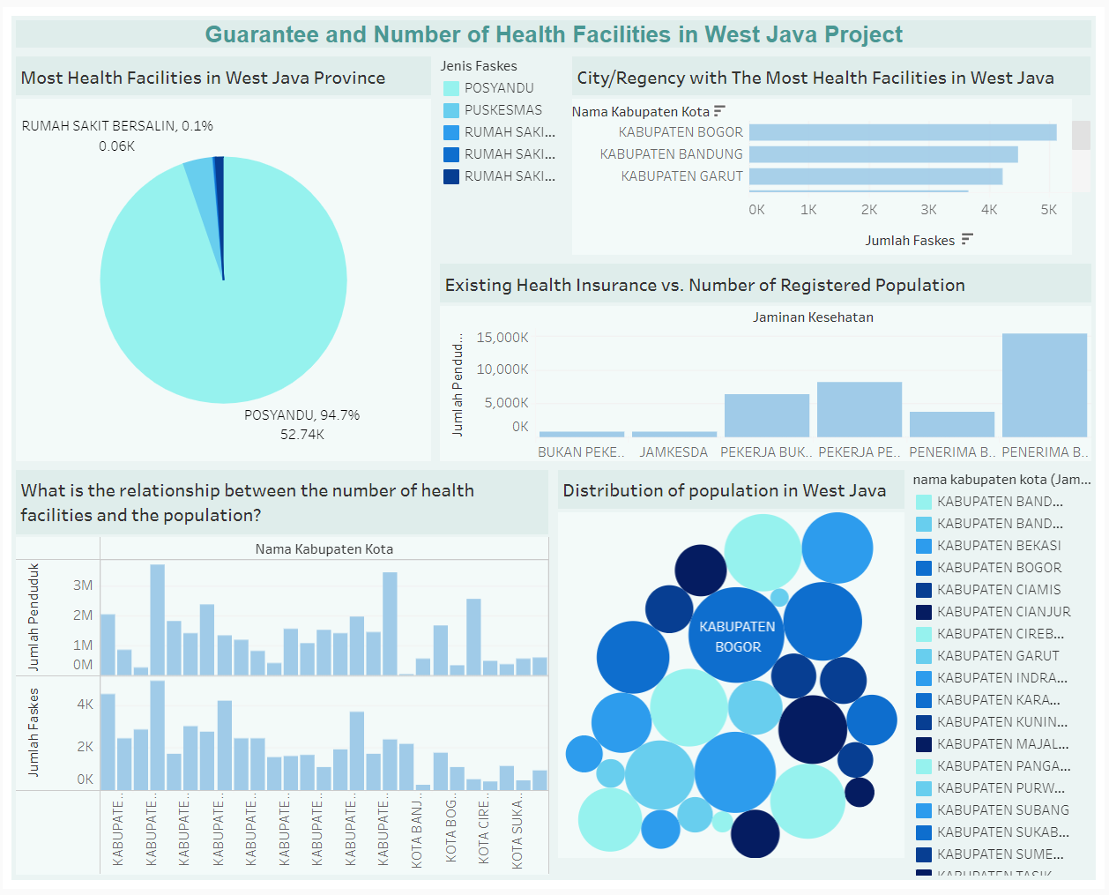
Dashboard Tableau
Link :
Dashboard - Health Facilities

Slide 15
THANK YOU
Dhea Amalia Lutfiani
(17 Oct – 21 OCT )

